Slide 1
Are there visible patterns in COVID-19 test data compared to Boston’s reopening?

Slide 2
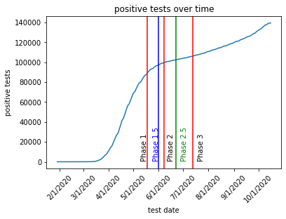
Graph shows cumulative positive tests in the city of Boston from 1/29/20 to 10/16/2020
The dates of the reopening phases in the city of Boston are indicated as vertical lines. Important details for each phase on next slide (note that the city of Boston delayed some reopening phases from the statewide date)

Slide 3
Phase 1
Retail open for curbside pickup only
Barbershops, pet grooming, car washes open
Construction resumse
Phase 1.5
Offices reopen for limited capacity
Phase 2
Retail with occupancy limits reopens
Outdoor table service for restaurants
Hotels
Outdoor recreation areas
Phase 2.5
Indoor table service
Close-contact personal services
Phase 3
Movie theaters, museums, cultural sites
Revised guidance for gatherings
Gyms

Slide 4
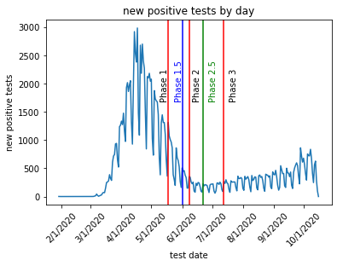
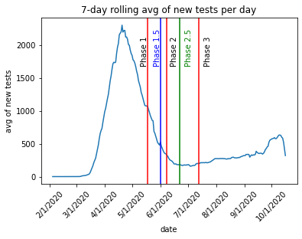
We can see that both the absolute number of new positive tests per day and the rolling average tends to go down before Phase 2.5 (periodization of the absolute number of new positive tests can be attributed to lower test numbers on weekends)
We can see that the downward slope of the 7-day rolling average stops at the beginning of phase 2.5, which aligns with indoor dining and close-contact personal services.
Importantly, we notice that the number of COVID-19 cases falls until indoor, close-contact activities are reintroduced, with a clear inflection point at that date in the state’s reopening. All things being equal, we can assume that these activities are driving increases in the positive test rates – i.e. driving new infections.

Slide 5
All things being equal, we should pursue the following inquiries:
Are indoor/close contact activities driving an increase in positive tests (i.e. driving infection rates)?
What percentage of the city’s workforce is now back to “in-office” work? Does increased in-office workers correlate with increases in positivity rates?
Do inflection points exist where national guidance was provided (e.g. date of mask mandates, cancellation of presidential debate, etc)
Are there a significant number of people participating in close, indoor activities? Could the inflection point be more psychological – people feel safer lowering their risk mitigation strategies because they hear indoor activities are “safe”?

